Slide 1

EAGLEXIT
OUR COMMUNITY
OUR CHOICE

Slide 2
Town Hall Meeting
June 23, 2026
Special Guest Speaker: Sharon Lechner
Notes:
Home rule gives municipalities legislative authority unless specifically denied by state law or charter. This contrasts with general law municipalities, which requires state permission.

Slide 3


About Us
Meeting Agenda
  Pledge Of Allegiance
  Invocation
  Introduction
  Financial Update
  Timeline
  Sharon Lechner: Can we afford to Detach?
  Q & A
  Conclusion
We are a group of residents with the goal to detach from the MOA and incorporate as a home rule brough called the Chugach Regional Brough (CRB).
With the support of our community, we fight to bring this idea to the public for their right to vote and our voices to be heard.

Slide 4
Eaglexit
Financial Mechanics of Separation

Slide 5
Bio
Auditor of governmental entities such as the Alaska Permanent Fund, AIDEA, the Alaska Student Loan Corporation, and the State of Alaska Treasury
Controller of the MOA
CFO of Anchorage Water and Wastewater Utility
CFO of the Municipality of Anchorage under Mayors Mark Begich and Matt Claman
OMB Director under Mayor Dave Bronson
MBA (University of Washington) / CPA licensed in WA and AK (licenses inactive status)

Slide 6
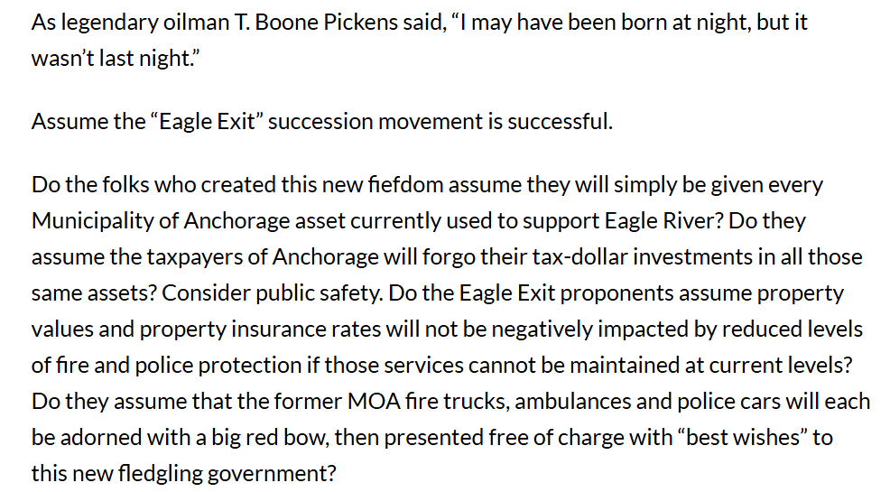
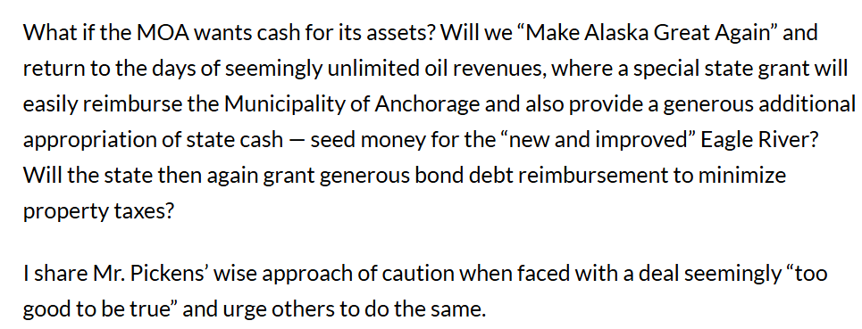
ADN 2024 Letter to the Editor

Slide 7
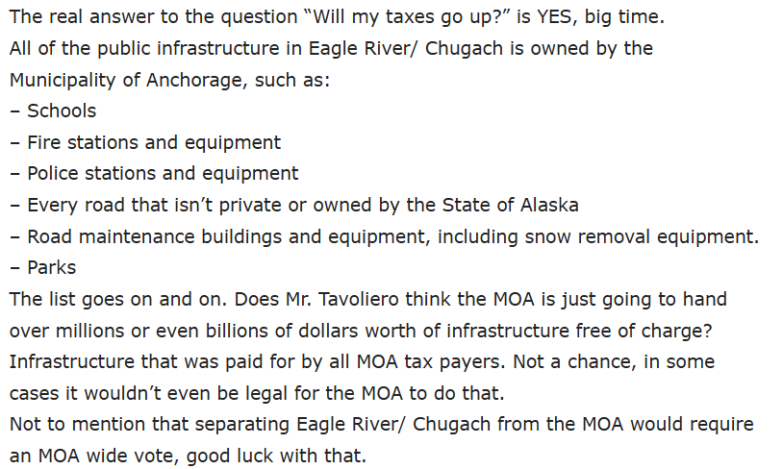
2023 Post

Slide 8
Topics
Are those writers correct?
  Does the new borough get the assets for free?
  Would taxes soar after a split?
How would a split work, financially?
Is a split even possible?

Slide 9
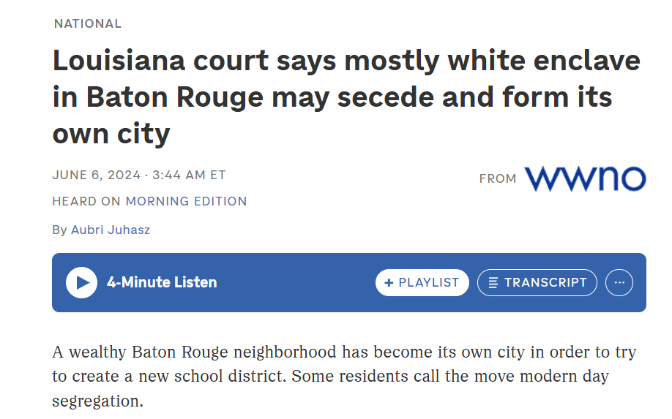
Is a split even possible?

Slide 10
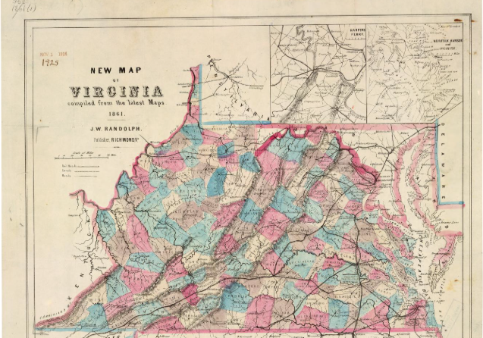
Is a split even possible?

Slide 11
Are These Writers Correct?
Would (or could) the MOA donate billions of dollars in assets to the new borough? Schools, roads, parks, fire stations, etc.
Would (or could) the MOA stay responsible for all existing debt, including GO bonds?
No. ER/Chugiak taxpayers have contributed, through the taxes they pay, into MOA assets
  Some assets (and related liabilities) would be allocated to the future borough
  Some debt would be owed by the future borough

Slide 12
Numbers are Stale
The MOA has not issued an ACFR since the December 31, 2023 ACFR was recently issued
The MOA does not produce year to date financial statements though it does produce some projections
The numbers in these slides are from the 2022 ACFR
ASD numbers are from their 6.30.2024 ACFR

Slide 13
Acronyms
ACFR means Annual Comprehensive Financial Report (aka, year end financial statements)
ASD means the Anchorage School District
CRB will refer to the future borough, post-split
GO means General Obligation (i.e., general obligation bonds)
LRSA means Limited Road Service Area
MOA will often refer to the MOA, post-split
MESA – Municipal Enterprise Service Assessment (like a property tax)
MUSA – Municipal Utility Service Assessment (like a property tax)

Slide 14
How Would Assets and Liabilities be Divided?
1) Some belong 100% to either the MOA or to the future borough
2) Some should not be divided; they should remain intact with little change
3) Some assets and liabilities should be divided based on relative populations
4) Some should be divided based on a hybrid approach, because a population split would not be fair

Slide 15
How Big is the MOA?
$9.0 billion in assets incl ASD
$4.3 billion in liabilities
$4.7 billion in equity (“net position”)
(MOA ACFR, Exhibit A-1)

Slide 16
Some Assets / Liabilities are Easy to Divide
Parks & Rec
Building Safety Service Area
Chugiak Fire Service Area
LRSAs

Slide 17
Parks & Rec
Anchorage Bowl Parks & Rec
  Assets $4.7m / Fund Balance $3.7m
  CRB has no claim on the assets, liabilities, and fund balance of this fund, because its residents have not paid taxes into this fund
Eagle River-Chugiak Parks & Rec
  Assets $7m / Fund Balance $6.8m
  The MOA has no claim on this fund’s assets, liabilities, and fund balance, because it has been funded with taxes paid by CRB taxpayers
  Source: page 3 of Detailed Statements

Slide 18
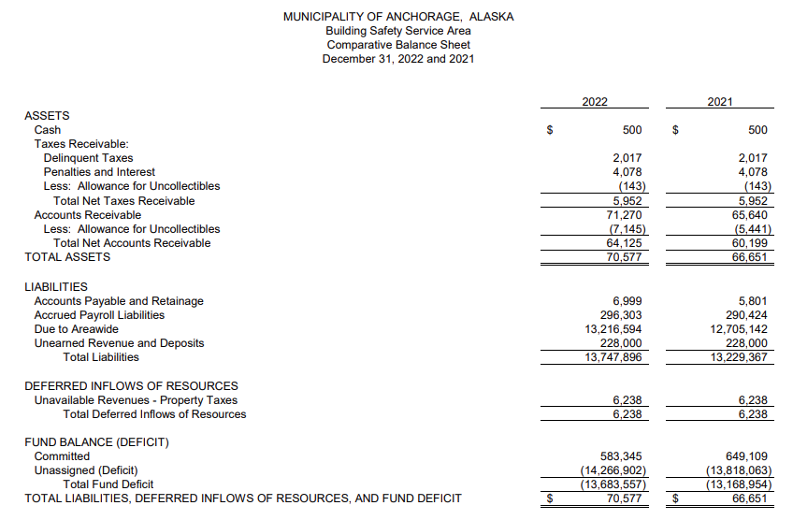
Building Safety Service Area
CRB has no responsibility for this fund’s $14m+ deficit, because this fund has been under-taxing the residents in the “Anchorage” service area (MOA residents)
Source: page 3 of Detailed Statements

Slide 19
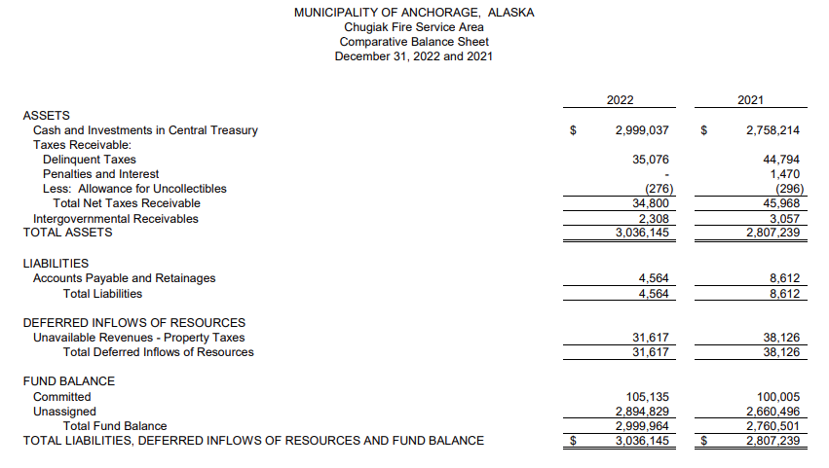
Chugiak Fire Service Area
The MOA would have no claim on the assets, liabilities, and fund balance of this fund, because it has been funded with taxes paid by Chugiak taxpayers.
Source: Page 1 of Detailed Statements

Slide 20
Subtotal – So Far (numbers are in millions)

Slide 21
Limited Road Service Areas
Most should be easy to allocate to either the MOA or to the future borough
Who has paid taxes into each service area? CRB taxpayers, or MOA taxpayers?

Slide 22
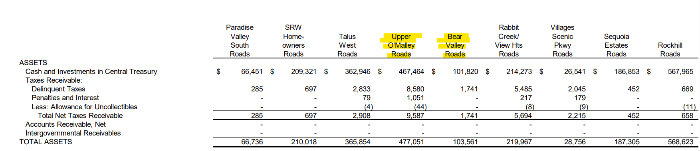
Limited Road Service Areas
Two highlighted examples represent LRSA assets that CRB would have no claim on, because its taxpayers have not contributed taxes into those funds.
Source: pages “59” and “60” from the Detailed Statements

Slide 23
Subtotal with LRSAs Added
Most of the LRSA assets should be retained in their entirety by the MOA.

Slide 24
Any “Hybrid” Service Areas?
Anchorage Metropolitan Police Service Area is a large fund that not all (current) MOA taxpayers pay into
Fire Service Area is a large fund that many CRB residents don’t pay into; they pay taxes into the Chugiak Fire Service Area
Etc.
At the time of separation, population figures would adjust to account for the proportionate share of participating taxpayers
Example: CRB would receive a proportionally lower share of Fire Service Area assets, liabilities and fund balance

Slide 25
All Service Areas, incl. Police and Areawide (38 funds so far)

Slide 26
Some Assets / Liabilities should not be divided
AWWU
Refuse
Solid Waste
Port
Municipal Airport
ML&P ??
Hydropower ??

Slide 27
Why not divide AWWU, SWS, Refuse, the Municipal Airport, and the Port?
Regulated utilities such as AWU and ASU would require RCA approval to split up. Approval would require showing that the split(s) are in the public’s best interest, and that would be difficult to demonstrate
Splitting up these enterprise funds would be challenging because of their outstanding revenue bonds
Splitting up the assets of the Municipal Airport is likely impossible due to its primary funding source (federal government)
Splitting up these enterprise funds would offer CRB very little. AWU pays an undersized dividend, ASU pays no dividend, the airport pays no dividend, etc.

Slide 28
Why not divide AWWU, SWS, Refuse, the Municipal Airport, and the Port, cont.?
Instead of a very disruptive attempt to split the assets, liabilities and fund balance, only the economic benefits generated by these entities, if any, should be shared
The MOA and the CRB would each assess and collect MUSA and MESA
MUSA and MESA would be comingled and any dividends paid by the enterprise funds would be added. Sum = economic benefits
The economic benefits would be shared based on a relative population split

Slide 29
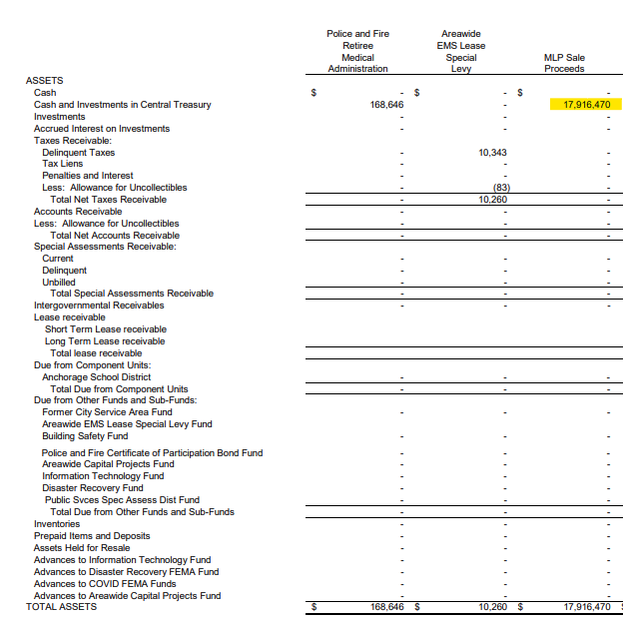
What about ML&P?
As of 12/31/2022, residual funds relating to the sale of ML&P remained. The future borough has a claim on its share of those assets / fund balance, if any assets continue to remain in this fund.

Slide 30
Are there other “future economic benefit” funds?
Alaska Center for the Performing Arts (economic benefits are negligible at the current time)
Anchorage Community Development Authority
CIVIC Center, CIVICVenture funds, Egan Center

Slide 31
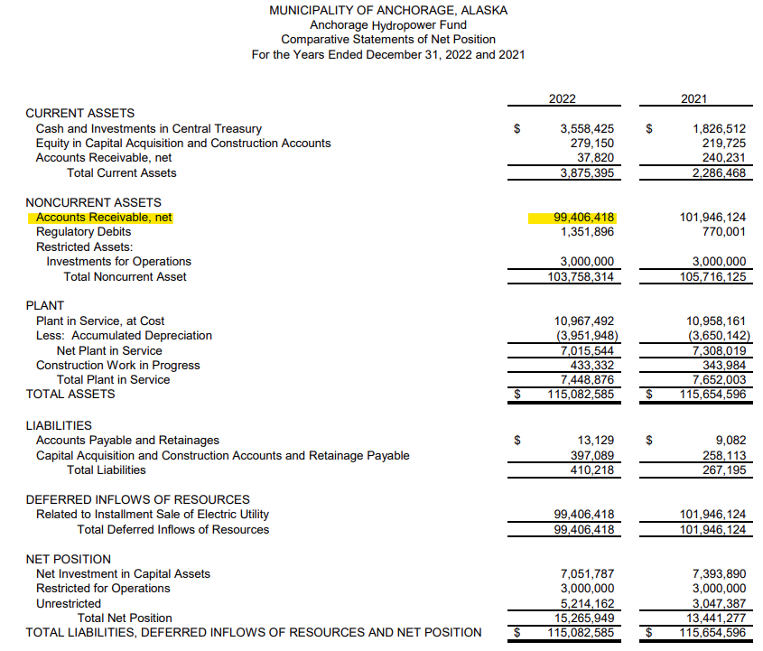
What about Hydro?
The Anchorage Hydropower fund exists because CEA could not afford to purchase ML&P’s assets outright when ML&P was sold
A population-based split of assets, liabilities and fund balance will fairly allocate the value of this fund
In addition, CRB should receive a fair share of future economic benefits such as net power sale revenues

Slide 32
Some Assets and related liabilities can be Allocated by Population
Heritage Land Bank assets and other real estate (except real estate owned by the enterprise funds and component units such as AWU and ASU)
MOA Trust Fund ($381 million)
Schools

Slide 33
Many Different Allocation Methodologies
Service Area that Eagle River / Chugiak has no interest in (example: Girdwood Valley Service Area)
Service Area that Eagle River / Chugiak has sole interest in (example: Chugiak Fire Service Area)
Service Area that Eagle River / Chugiak has a reduced interest in (example: Fire Service Area)
Service Area that Eagle River / Chugiak has an enhanced interest in (example: Anchorage Metropolitan Service Area)
Split pro-rata (example: Areawide Service Fund)
Fund cannot be split at the present time due to debt covenants; Split pro-rata claim once debt covenants allow or the debt has been fully repaid (example: CIVIC Ventures Revenue Bond)
Share future economic benefits such as MUSA, MESA, net power sales, purchase payment stream, and dividends pro-rata (example: Port)
Internal Service Fund - split pro-rata (example: Equipment Maintenance)
Internal Service Fund – MOA retains this fund (IT, etc.)
Waive possible interest in fund (example: 49th State Angel Fund)
Allocate pro-rata with Chugiak / ER portion representing a restricted asset / continued obligation (example: police & fire retiree obligation)

Slide 34
What about GO Bond Debt?
GO Bond debt would be refinanced into two tranches of new GO Bond debt:
  Most of the new GO Bond debt would be the MOA’s
  Some of the new GO Bond debt would be CRB’s
  CRB would bear the costs of the refinancing (CRB’s share of the MOA Trust Fund can fund these transactional costs)
  Split would be population-based, since GO Bond debt is an obligation of the entire MOA

Slide 35
Fund Balance Totals
ASD figures were pulled from ASD’s 6.30.2024 ACFR rather than from the stale 12.31.2022 MOA ACFR. Due to ASD’s capital-intensive operations, net position was pulled rather than fund balance.

Slide 36
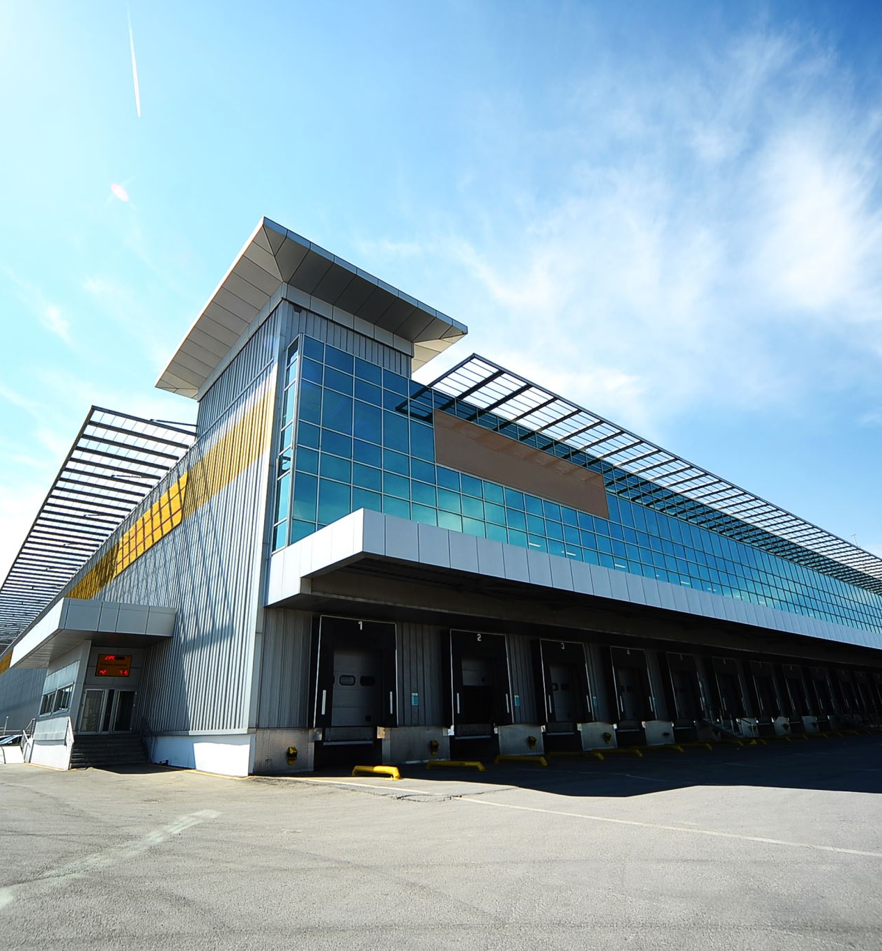
New Infrastructure Needed?
Animal shelter
A city hall, which could be leased space

Slide 37
What About Taxes After Separation?
Health Department
Equity and Justice
Equal Opportunity
Internal Audit
Ombudsman
Equal Rights
Spending to support individuals experiencing homelessness and mental health issues
Grants to non-profits
Assembly

Slide 38
What About Taxes After Separation?
Reallocation of “fully loaded” taxes currently being paid:
Public Transportation: $32.2m budget.
Police: $138.8m budget.
Did CRB’s taxpayers receive fair levels of police and public transportation services for the taxes paid in?

Slide 39
Challenges With the Process
Cooperation from the MOA
Limited information
Agreeing on methodologies
Administrative support during transition (example: payroll)

Slide 40
Questions?

Slide 41

Summary
We can't do this without you
  You are our community.
  We are doing this for you, but we need your support.

Slide 42






THANK YOU
Catherine Margolin, Chair
907-830-5456
Catherine.Eaglexit@gmail.com
www.Eaglexit.com

Slide 43
Thank you
www.Eaglexit.com

